Slide 1


IIT Gandhinagar 2017-18
ES-203
By Prof. Joycee Mekie
Assisted by: Sarath Chandran GM.
Team Member: Amit (16110011) | Ayush Garg(16110026) | Jatin Dholakia (16110066) | Rohit Sharma(16110141)

Slide 2
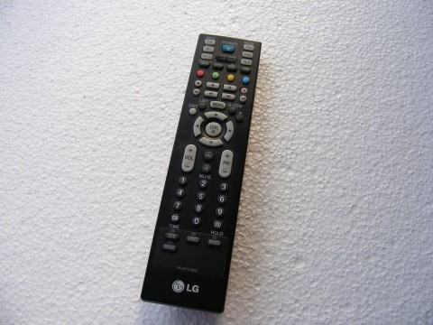

Aim: To make a Project using FPGA
Smart LG TV Remote

Slide 3
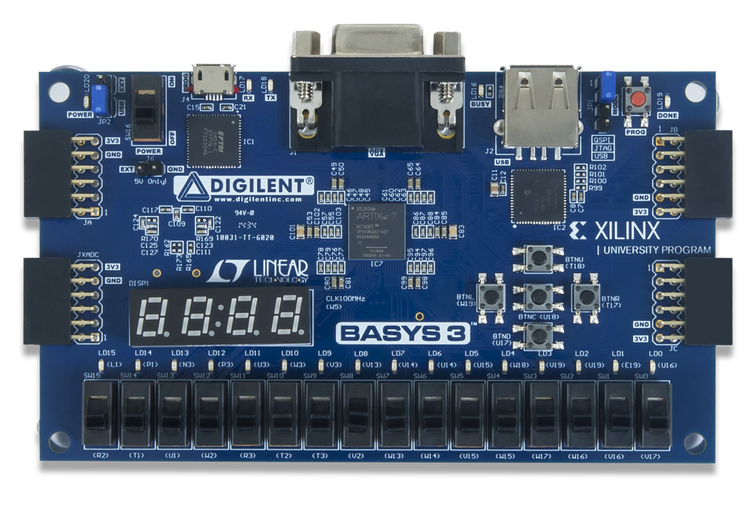
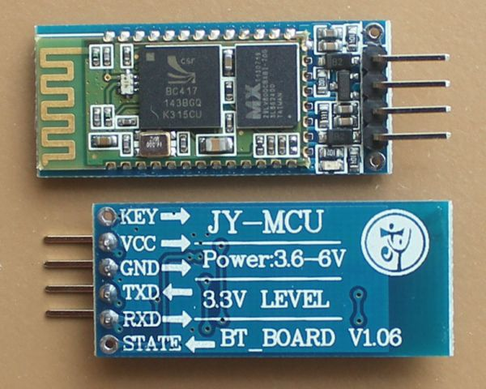
Material Required
FPGA Module- BASYS 2:
Bluetooth Module

Slide 4
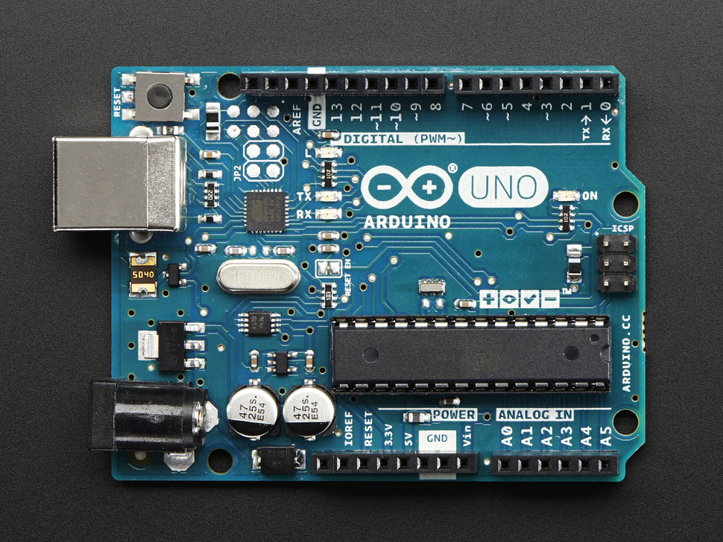
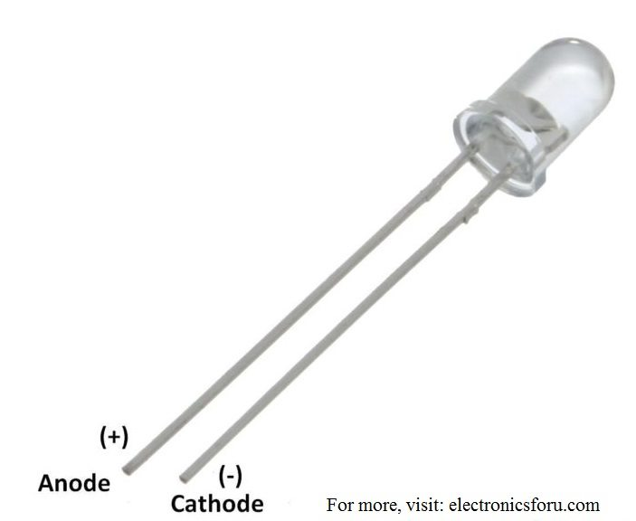
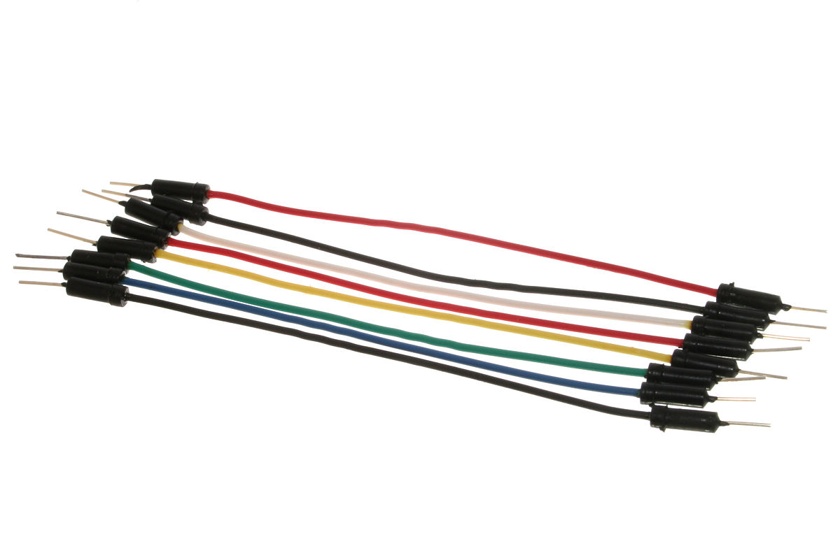
3. Arduino Uno
4. IR Transmitter Led
5. Jumper wires

Slide 5
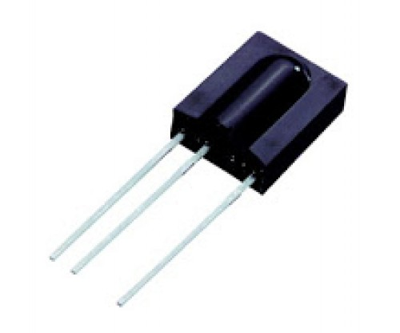
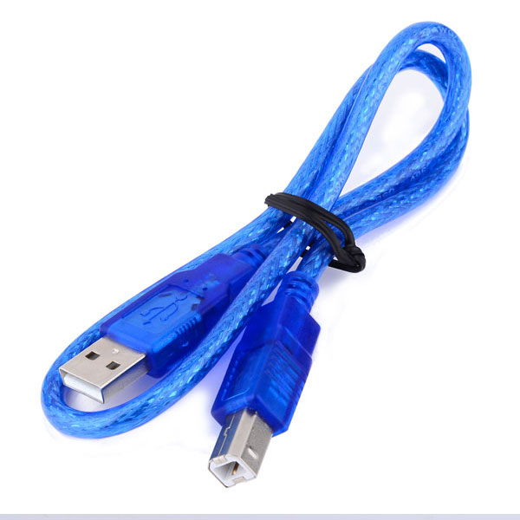
6. IR Receiver – SM038
7. USB to Arduino serial communication cable

Slide 6
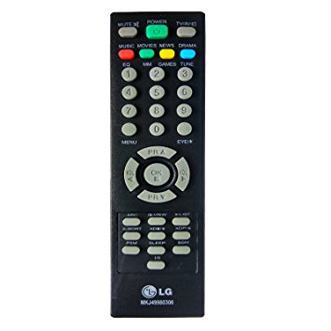
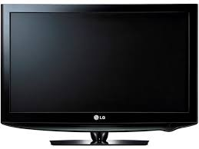
LG TV
LG TV Remote for test

Slide 7
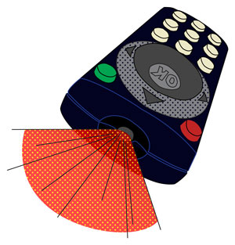
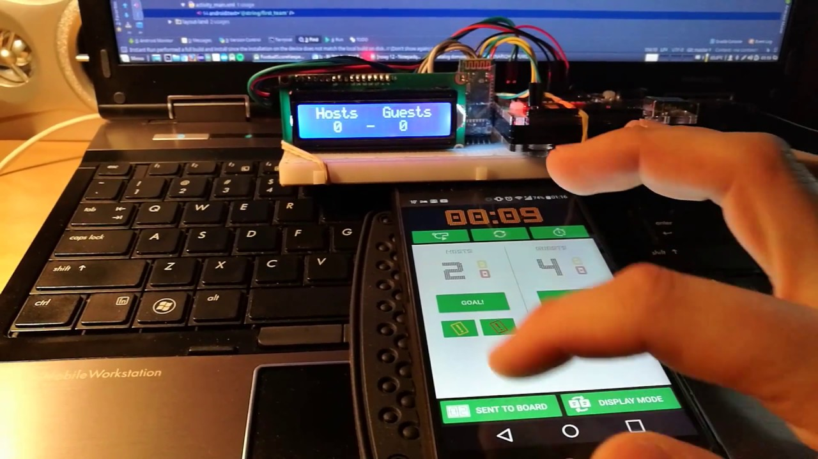
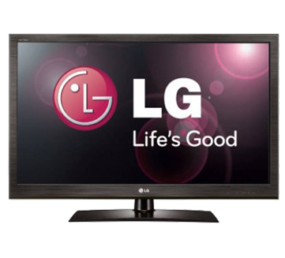
Block Diagram of Project
RS232
BLUETOOTH COMMUNICATION
FSM TO DECODE VALUE SEND IN ASCII
Communicating Phone with FPGA using HC-05
FPGA Implementing NEC Protocol and doing IR Transmission

Slide 8
Bluetooth Communication
We used HC-05 module for Bluetooth Communication between the phone and the FPGA for sending wireless data.
HC‐05 module is an easy to use Bluetooth SPP (Serial Port Protocol) module, designed for transparent wireless serial connection setup.
The HC-05 Bluetooth Module can be used in a Master or Slave configuration, making it a great solution for wireless communication.
This serial port Bluetooth module is fully qualified Bluetooth V2.0+EDR (Enhanced Data Rate) 3Mbps Modulation with complete 2.4GHz radio transceiver and baseband.
The serial communication is done using RS232 standards.

Slide 9
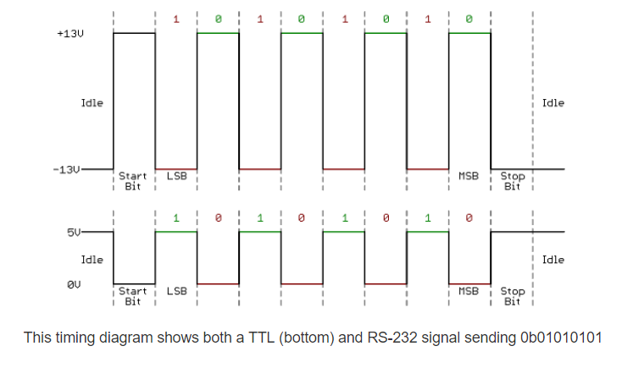
RS232 Standard
Level logic: TTL level: normal data represented using binary fixed +5 V equivalent to logic “1”, 0V is equivalent to logic “0”, referred to as a TTL signal system is the positive logic RS232 level:-12V to -3V, equivalent to a logic “0”, +3 V to +12 V logic level equivalent to logic “1” is a negative logic.

Slide 10
How We Implemented it on FSM
Bluetooth Module (HC 05) as Receiver
Frequency Division
2 input FSM
Reading each bit by shifting
Writing and storing in a 8-bit register.

Slide 11
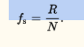
Bluetooth Receiver
Gross bit rate and Baud Rate
Baud Rate = 9600.
Bits for transferring one character = 10 (8 data bits, 1 start bit, 1 stop bit).
Hence characters sent per second : 9600/10 = 960.C

Slide 12
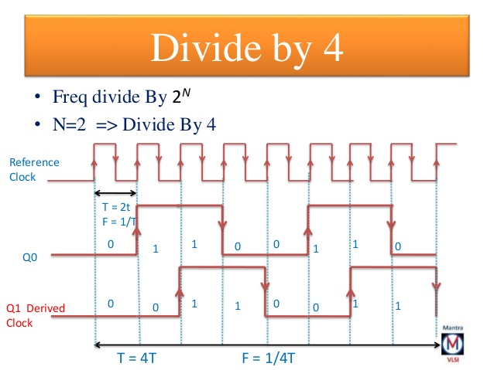
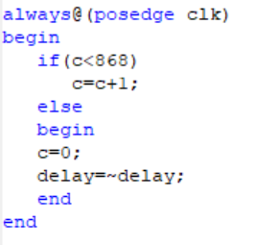
Frequency Division
Used for converting the inbuilt clock of 50MHz to 9600 bits/sec.
Dividing the clock frequency by 868.

Slide 13
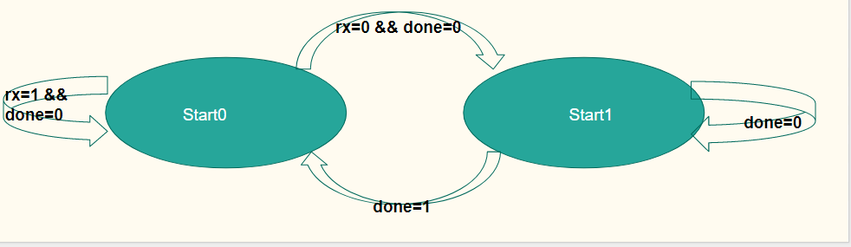
FSM
When the received bit becomes 0, the state changes to start0 and reads 8 bits at the sampling frequency.
When the stop bit is received, the done is set to 0 and the FSM reaches its RESET state (start1).

Slide 14
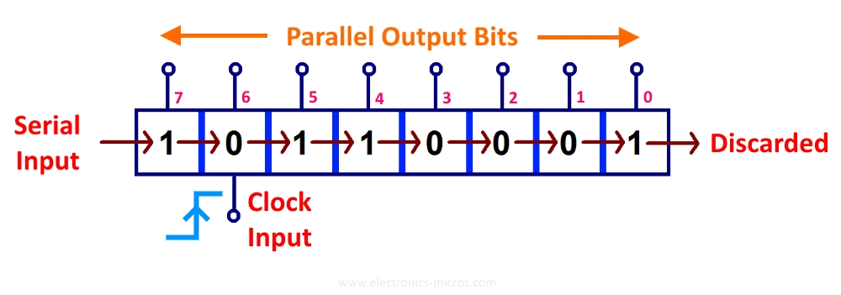
Shifting and Writing
A 9 bit register is right shifted in every clock cycle and received bit is written on the MSB.
When all the 9 bits are read (including the start bit), the protocol stops writing.
It again enters, the idle state and waits for the start bit (negedge).

Slide 15
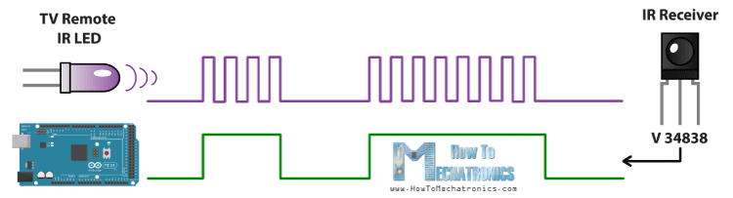
Implementation
Infrared (IR) light sends digitally-coded pulses of infrared radiation to control functions such as power, volume, channels, playback or other features varying from device to device when the user presses a button on the handset.

Slide 16
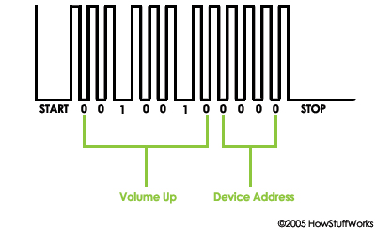
The infrared light pulses form a pattern unique to that button. The receiver in the device recognizes the pattern and causes the device to respond accordingly

Slide 17
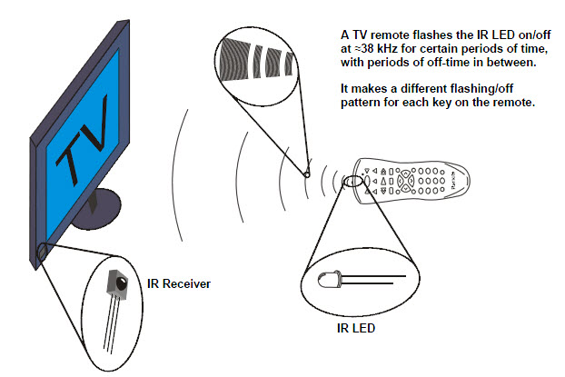
A TV remote flashes the IR LED on/off @38 kHz for certain periods of time with periods of off-time in between
It makes a different flashing pattern for each key on the remote

Slide 18
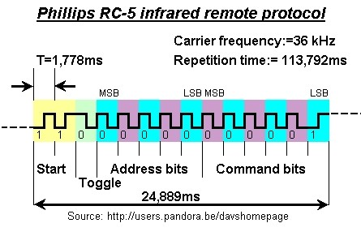
Different Protocols used by various Manufacturer

Slide 19
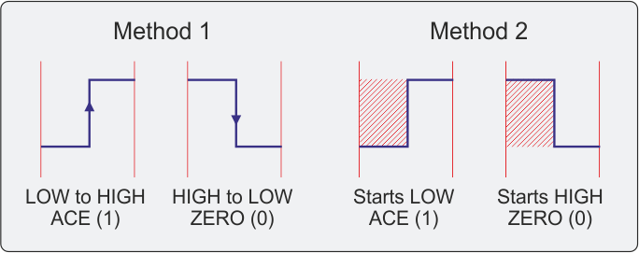
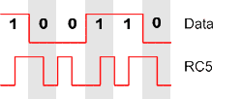
Each bit has a transition in the middle of the bit, and will have an additional transition at the start of the bit if it follows a bit of the same value.

Slide 20
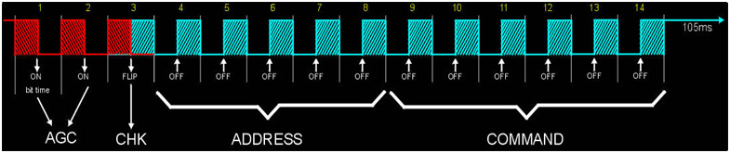
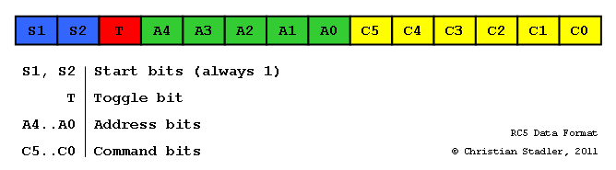
A 14-bit RC5 sequence starts with two sync bits (always 1), followed by a toggle bit (which alternates value on each key press), a 5 bit device address, and a 6-bit command number.
The toggle bit is a bit that it maintains the same as long as a key is pressed continuously, but if a key is released and is pressed back again (the same or a different key), the toggle bit is inverted.

Slide 21
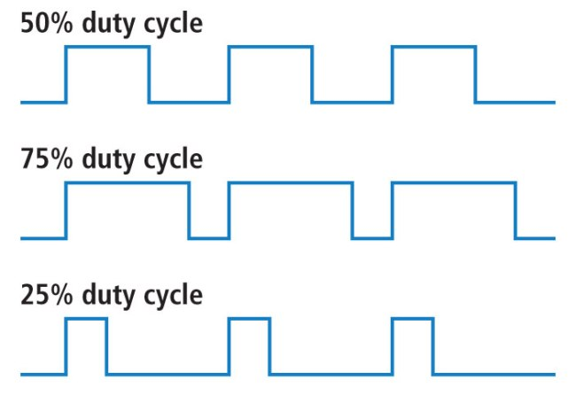
NEC Protocol used in LG TV
Duty Cycle
If we analyse any one clock cycle, duty cycle is the ratio of (duration of logical ‘1’)/(duration of total cycle)*100%

Slide 22
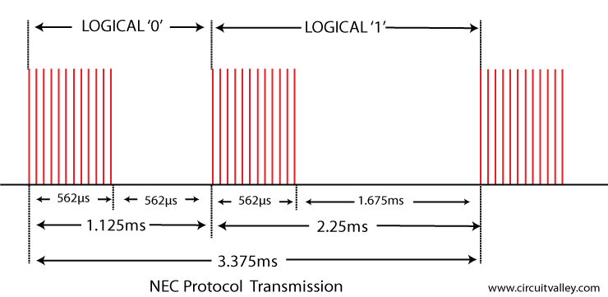
LOGICAL ‘0’ HAS 50% DUTY CYCLE. LOGICAL ‘1’ HAS 25 % DUTY CYCLE.
Image Courtesy : http://www.circuitvalley.com/2012/09/infrared-ir-nec-microcontroller-pic-avr.html

Slide 23
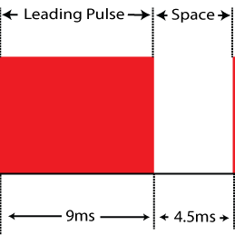
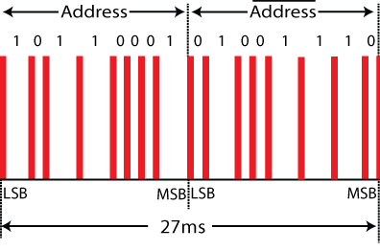
Whenever a signal is sent, a 9 ms pulse burst is passed which contains 25% duty cycle which is followed by a 4.5ms space
This is followed by a 8 bit address and 8 bit logical inverse of it.

Slide 24
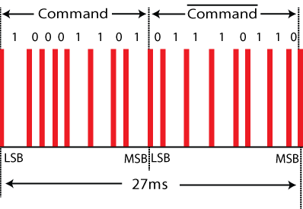
And at last the command is transferred in 8 bit followed by its 8 bit logical inverse. (which makes overall length same )
To signify the end of message transmission a final burst of 562.5µs is transmitted.

Slide 25
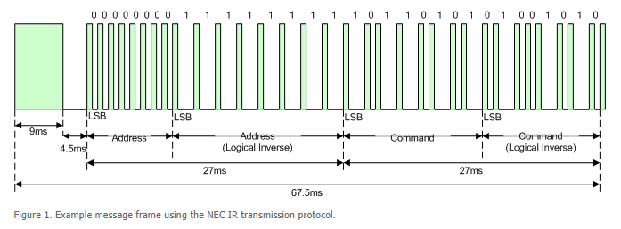
Complete Propagation of a Signal
https://exploreembedded.com/wiki/NEC_IR_Remote_Control_Interface_with_8051

Slide 26
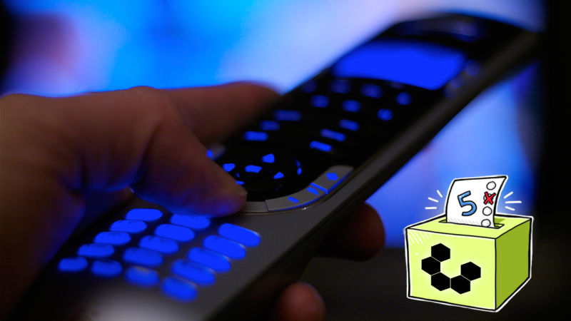
Project Extension: Making Universal IR Remote applicable to all devices

Slide 27
Project Video

Slide 28
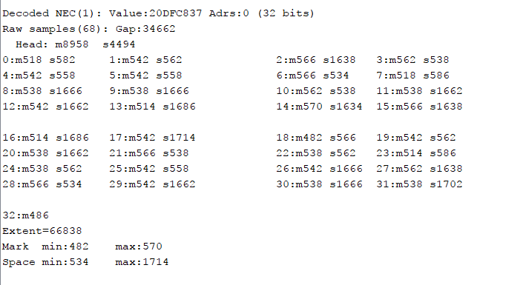
Conclusion
We were able to make a Bluetooth controlled smart T.V. Remote for L.G. T.V. By sending signals through Bluetooth on FPGA board by implementing NEC protocol. We would like to carry forward this work and would like to implement universal remote.
This diagram is expected output that we observed from Arduino using LG TV remote
Here s stands for space or 0 in the output from LED and m stands for mark or a clock cycle

Slide 29
Bibliography
https://exploreembedded.com/wiki/NEC_IR_Remote_Control_Interface_with_8051
http://www.circuitvalley.com/2013/09/nec-protocol-ir-infrared-remote-control.html
https://wiki.eprolabs.com/index.php?title=Bluetooth_Module_HC-05
https://www.slideshare.net/DeepakFloria/divide-by-n-clock
RC-5 algorithm explanation and its encryption and decryption -
http://ustr.sancaleve.com/infrared/infrared1.shtml
http://clearwater.com.au/code/rc5

Slide 30



